Slide 1



Salome Kungu_CS-DA03-26054_Power_BI
View in Power BI
Last data refresh:
08/02/2026 20:52:02 UTC
Downloaded at:
08/02/2026 20:55:18 UTC

Slide 2
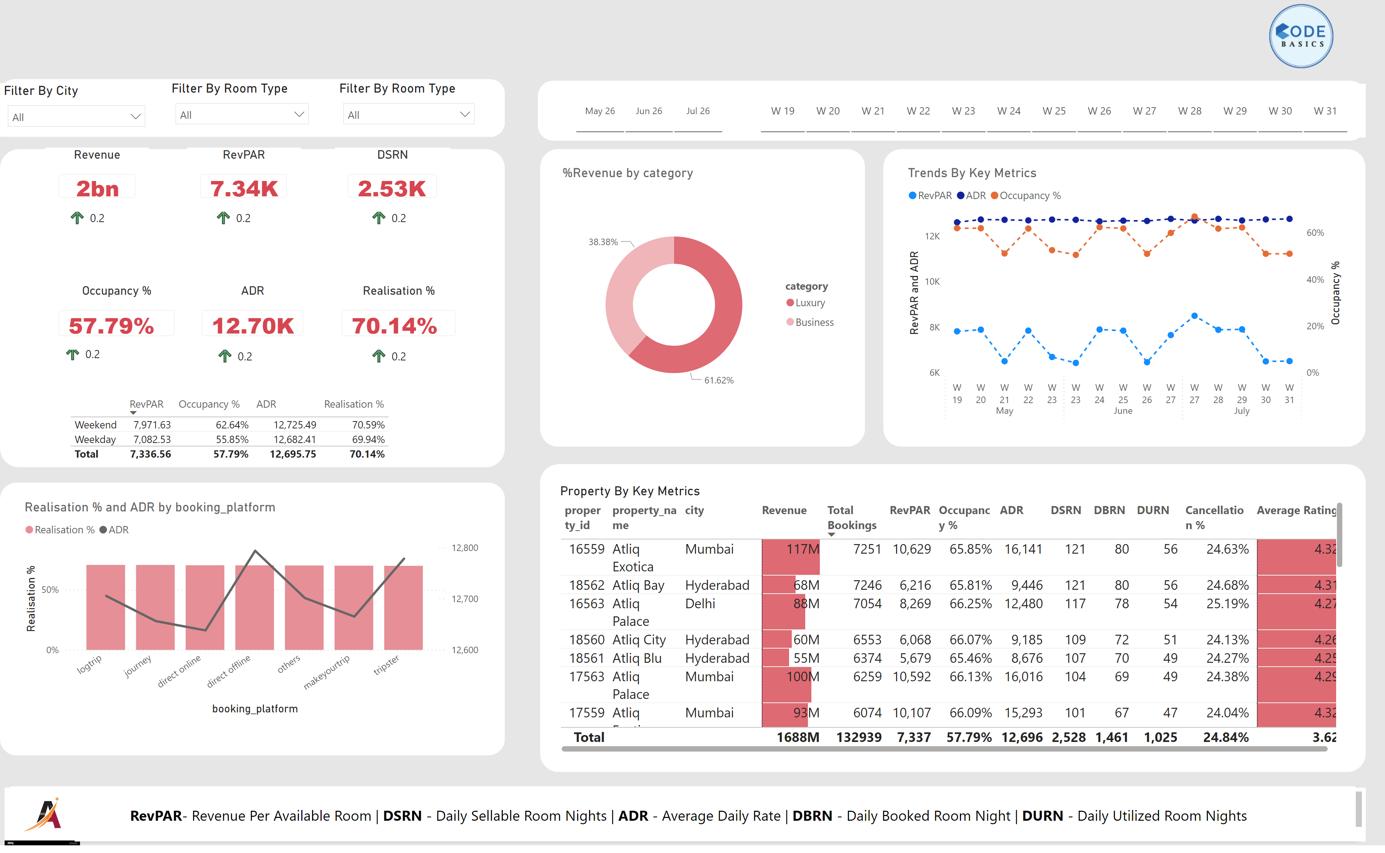
Page 1
Notes:
Property By Key Metrics
No alt text provided
Filter By City
No alt text provided
Filter By Room Type
No alt text provided
slicer
No alt text provided
slicer
No alt text provided
Revenue
No alt text provided
tableEx
No alt text provided
%Revenue by category
No alt text provided
tableEx
No alt text provided
tableEx
No alt text provided
RevPAR
No alt text provided
tableEx
No alt text provided
DSRN
No alt text provided
Occupancy %
No alt text provided
ADR
No alt text provided
Realisation %
No alt text provided
tableEx
No alt text provided
Trends By Key Metrics
No alt text provided
lineClusteredColumnComboChart
No alt text provided
tableEx
No alt text provided
tableEx
No alt text provided
shape
No alt text provided
shape
No alt text provided
shape
No alt text provided
shape
No alt text provided
shape
No alt text provided
shape
No alt text provided
shape
No alt text provided
shape
No alt text provided
image
No alt text provided
image
No alt text provided
shape
No alt text provided
textbox
No alt text provided
Filter By Room Type
No alt text provided

Slide 3
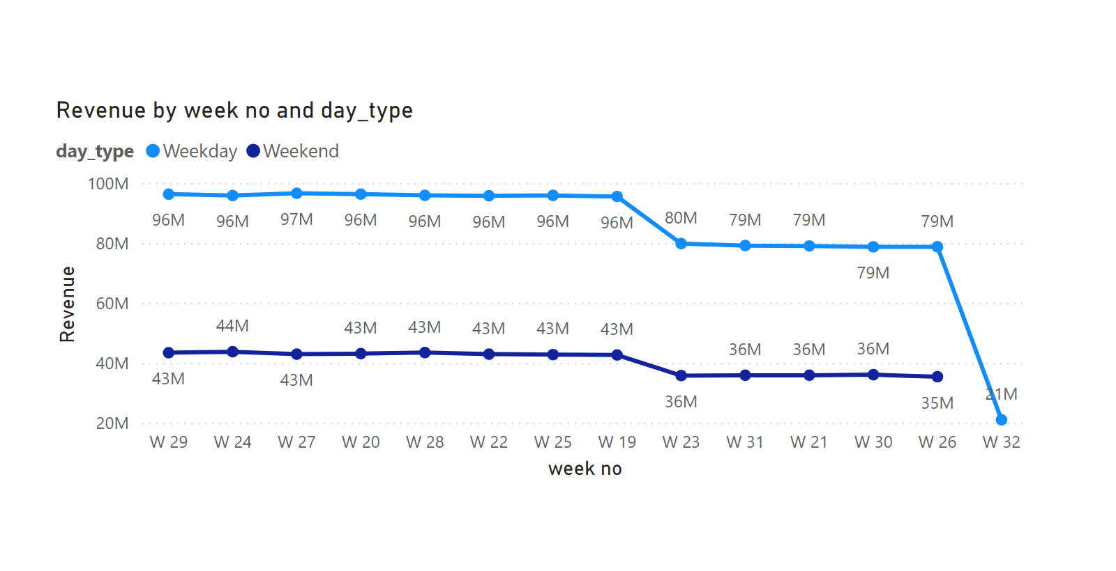
tooltip-revenue
Notes:
lineChart
No alt text provided

